Slide 1
System Development Methods CT00046-3-2
System Planning
Part 1

Slide 2
Topic & Structure of the Lesson
System Planning Strategies
Feasibility Study
Resource Planning Tools
Outsourcing Options

Slide 3
Learning Outcome
At the end of the module, you should be able to:
Explain the importance of system planning strategies.
Define operational, technical, economic, and schedule feasibility studies.
Describe various resource planning tools, including Gantt charts and PERT charts, and Work Breakdown Structure (WBS)
Discuss outsourcing options, including the role of service providers, reasons, and problems.

Slide 4
Key Terms you must be able to use
If you have mastered this topic, you should be able to use the following terms correctly in your assignment and exam:
System Planning Strategies
Feasibility Study
Resource Planning Tools
Outsourcing Options

Slide 5
Topic & Structure of the Lesson PART 1
System Planning Strategies
Feasibility Study
Resource Planning Tools
Outsourcing Options

Slide 6
System Planning Strategies

Slide 7
System Planning Strategies
System Planning Strategies is the process of identifying long-term organizational goals, strategies, and resources.
Systems planning is the first phase of the systems development life cycle. Effective information systems help an organization support its business processes, carry out its mission, and serve its stakeholders.
It allows a company to examine its purpose, vision, and values and develops a mission statement, which leads to goals, objectives, day-to-day operations, and business results that affect company stakeholders.
During the systems planning phase, an analyst reviews the business case, which is the basis, or reason, for a proposed system. A business case should describe the project clearly, provide the justification to proceed, and estimate the project’s financial impact.

Slide 8
System Planning Strategies (continued)
Problems Statement
Initial Study
Feasibility Study
Requirements Engineering / Elicitation
Resource Planning
Costing and Scheduling
Outsourcing Options

Slide 9
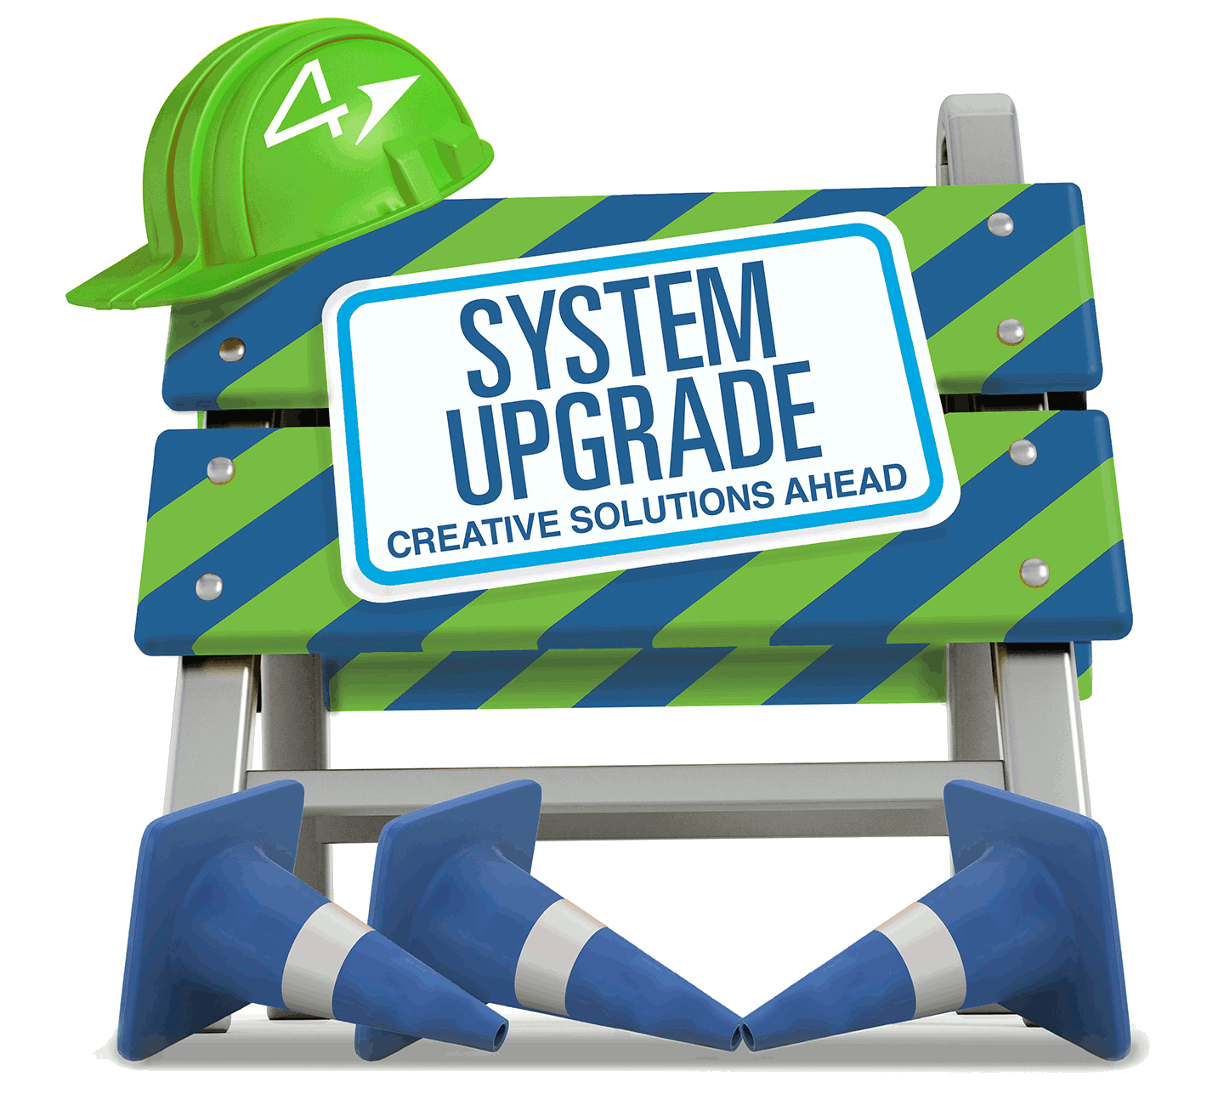
Problem Statement
Every new project starts to solve some type of ‘problem’ with a ‘current process’.
Defect to the old system
Bugs, user complaints, unable to support current increasing demand, etc.
Opportunity or need for an upgrade
The directive, competition, available budget, available new technology, etc.
‘Problems’ usually reported by users / customers using the old/existing system.

Slide 10

Initial Study Process
Conducted by expert / consultant on the existing (old) system
System Analyst, System Engineers
Study ‘Problem Statement’
Verify problems that are reported to the existing system.
Find the source / cause of the problems.
Narrow down solutions to solve problem.
Propose possible solutions.
Options – to upgrade, replace, etc.
Create Project Proposal.
Present suggested solution to customer / business owner

Slide 11
Feasibility Study

Slide 12

Feasibility Study
Conducted by potential developer
Project owner hires Developer
IN-HOUSE developers
VENDORS hired through project tendering process.
Developer conducts FEASIBILITY STUDY to see if the project can be done according to owner’s requirements.
Output – Feasibility Study Report

Slide 13
The Importance of Feasibility Study
When to do a Feasibility Study (FS)?
Before starting a project.
When the main requirements are clear.
When are all projects feasible ?
When most of the facts analysed had a positive outcome, such as profit, benefits, solutions, etc.
What happens when the FS fails (negative outcome)?
The project may be suspended / scrapped.
Vendors might not take up the project.

Slide 14

Common types of Feasibility Study
Technical feasibility
Schedule feasibility
Economic feasibility
Operational feasibility
Legal feasibility
Cultural feasibility.

Slide 15
Operational Feasibility Study
Operational feasibility means that a proposed system will be used effectively after it has been developed. If users have difficulty with a new system, it will not produce the expected benefits.
Operational feasibility depends on several vital issues. For example, consider the following questions:
Does management support the project? Do users support the project? Is the current system well-liked and effectively used? Do users see the need for change?
Will the new system result in a workforce reduction? If so, what will happen to affected employees?
Will the new system require training for users? If so, is the company prepared to provide the necessary resources for training current employees?

Slide 16
Operational Feasibility Study (continued)
Will users be involved in planning the new system right from the start?
Will the new system place any new demands on users or require any operating changes? For example, will any information be less accessible or produced less frequently? Will performance decline in any way? If so, will an overall gain to the organization outweigh individual losses?
Will customers experience adverse effects in any way, either temporarily or permanently?
Will any risk to the company’s image or goodwill result?
Does the development schedule conflict with other company priorities?

Slide 17
Technical Feasibility Study
Technical feasibility refers to the technical resources needed to develop, purchase, install, or operate the system. When assessing technical feasibility, an analyst must consider the following points:
Does the company have the necessary hardware, software, and network resources? If not, can those resources be acquired without difficulty?
Does the company have the needed technical expertise? If not, can it be acquired?
Does the proposed platform have sufficient capacity for future needs? If not, can it be expanded?
Will a prototype be required?

Slide 18
Technical Feasibility Study (continued)
Will the hardware and software environment be reliable? Will it integrate with other company information systems, both now and in the future? Will it interface properly with external systems operated by customers and suppliers?
Will the combination of hardware and software supply adequate performance? Do clear expectations and performance specifications exist?
Will the system be able to handle future transaction volume and company growth?

Slide 19
Economic Feasibility Study
Economic feasibility means that the projected benefits of the proposed system outweigh the estimated costs usually considered the total cost of ownership (TCO), which includes ongoing support and maintenance costs, as well as acquisition costs.
To determine TCO, the analyst must estimate costs in each of the following areas:
People, including IT staff and users
Hardware and equipment
Software, including in-house development as well as purchases from vendors
Formal and informal training, Licenses and fees, Consulting expenses, Facility costs, The estimated cost of not developing the system or postponing the project

Slide 20
Economic Feasibility Study (continued)
In addition to costs, you need to assess tangible and intangible benefits to the company.
The systems review committee will use those figures, along with your cost estimates, to decide whether to pursue the project beyond the preliminary investigation phase.
Tangible benefits are benefits that can be measured in dollars. Tangible benefits result from a decrease in expenses, an increase in revenues, or both. Examples of tangible benefits include the following:
A new scheduling system that reduces overtime
An online package tracking system that improves service and decreases the need for clerical staff
A sophisticated inventory control system that cuts excess inventory and eliminates production delays

Slide 21
Economic Feasibility Study (continued)
Intangible benefits are advantages that are difficult to measure in dollars but are important to the company. Examples of intangible benefits include the following:
A user-friendly system that improves employee job satisfaction
A sales tracking system that supplies better information for marketing decisions
A new Web site that enhances the company’s image

Slide 22
Schedule Feasibility Study
Schedule feasibility means that a project can be implemented in an acceptable time frame. When assessing schedule feasibility, a systems analyst must consider the interaction between time and costs. For example, speeding up a project schedule might make a project feasible, but much more expensive. Other issues that relate to schedule feasibility include the following:
Can the company or the IT team control the factors that affect schedule feasibility?
Has management established a firm timetable for the project?
What conditions must be satisfied during the development of the system?
Will an accelerated schedule pose any risks? If so, are the risks acceptable?
Will project management techniques be available to coordinate and control the project? Will a project manager be appointed?

Slide 23
Other types of Feasibility Study
Legal feasibility
Investigates whether any aspect of the proposed project conflicts with legal requirements e.g., zoning laws, data protection, privacy issues, etc.
Cultural feasibility
The organizational structure of the business.
Management’s competency, professional skills, and experience.

Slide 24
Resource Planning

Slide 25

Resource Planning
Resource Planning is important, especially to estimate time and cost of the project
Normally done at the early stage of planning, with clear requirements
Involves activities:
Define scope
Human resource planning
Resource costing
Resource scheduling and job delegation
Equipment planning – Hardware, software, etc.
Resource RISK Planning

Slide 26
Resource Planning Tools
Tools used for Resource Planning:
PERT Chart & Gantt Chart – For project activities and human resources planning.
Work Break-down Structure - A work breakdown structure (WBS) involves breaking a project down into a series of smaller tasks.
Hierarchy Task Analysis - For task restructuring.

Slide 27
Resource Planning Project scheduling
Project scheduling involves the creation of a specific timetable, usually in the form of charts that show tasks, task dependencies, and critical tasks that might delay the project. Scheduling also involves selecting and staffing the project team and assigning specific tasks to team members. Project scheduling uses Gantt charts and PERT charts.
Watch the following video to know more about the project scheduling:
https://www.youtube.com/watch?v=WNWSQOynrl0&ab_channel=ProjectManager

Slide 28
Resource Planning Gantt Chart
Gantt charts were developed almost 100 years ago by Henry L. Gantt, a mechanical engineer and management consultant.
A Gantt chart is a horizontal bar chart that represents a set of tasks. It displays tasks in a vertical array, with time shown on the horizontal axis.
The position of the bar shows the planned starting and ending time of each task, and the length of the bar indicates its duration. On the horizontal axis, time can be shown as elapsed time from a fixed starting point, or as actual calendar dates.
A Gantt chart also can simplify a complex project by combining several activities into a task group.

Slide 29
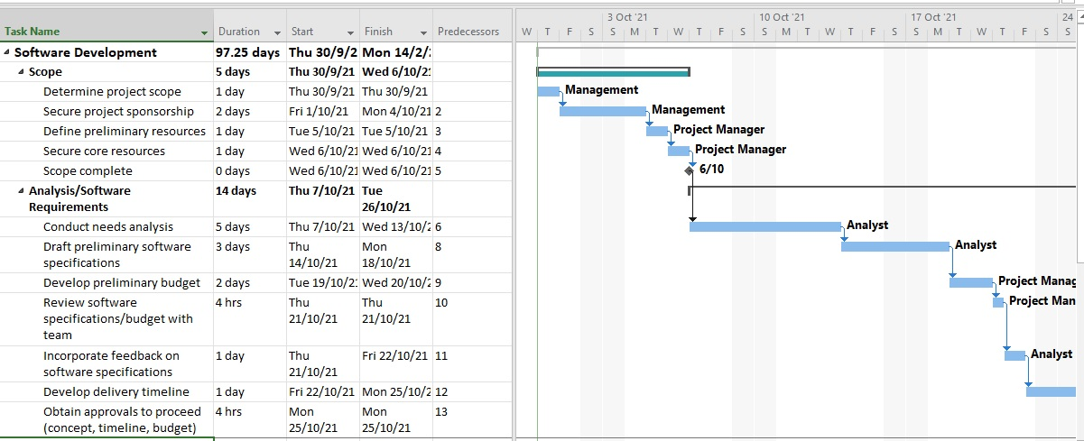
Resource Planning Gantt Chart Example

Slide 30
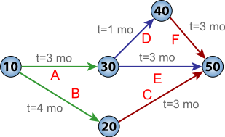
Resource Planning PERT Chart
The Program Evaluation Review Technique (PERT) was developed by the U.S. Navy to manage very complex projects, such as the construction of nuclear submarines. It analyzes a large, complex project as a series of individual tasks.
To create a PERT chart, first identify all the project tasks and estimate how much time each task will take to perform.
Next, determine the logical order in which the tasks must be performed. For example, some tasks cannot start until other tasks have been completed. In other situations, several tasks can be performed at the same time.
Once you know the tasks, their durations,
and the order in which they must be
performed, you can calculate the time that
it will take to complete the project. You also
can identify the specific tasks that will be
critical to the project’s on-time completion.

Slide 31
Resource Planning Work Breakdown Structure (WBS)
A work breakdown structure must clearly identify each task and include an estimated duration.
A task, or activity, is any work that has a beginning and an end and requires the use of company resources such as people, time, or money.
Examples of tasks include conducting interviews, designing a report, selecting software, waiting for the delivery of equipment, or training users.
Tasks are basic units of work that the project manager plans, schedules, and monitors - so they should be relatively small and manageable.

Slide 32
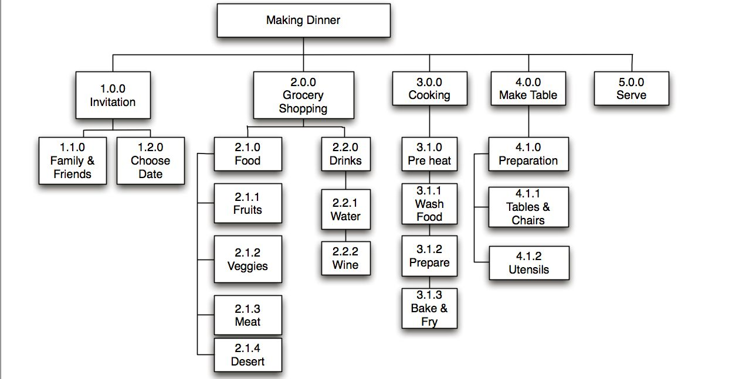
Resource Planning WBS Example
LISTING THE TASKS While this step sounds simple, it can be challenging, because the tasks might be embedded in a document.
One trick is to start by highlighting the individual tasks.
The next step is to number the tasks and create a table.

Slide 33
Outsourcing Options

Slide 34
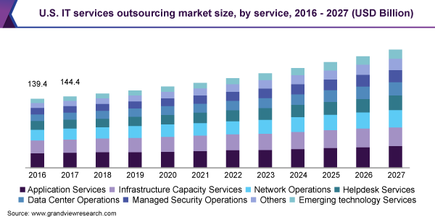
Outsourcing
IT outsourcing is the use of external service providers to effectively deliver IT-enabled business processes, application services, and infrastructure solutions for business outcomes.
Traditionally, firms outsourced IT tasks as a way of controlling costs and dealing with rapid technological change. While those reasons still are valid, outsourcing has become part of an overall IT strategy for many organizations.

Slide 35
Outsourcing Role of service providers
Two popular outsourcing options involve application service providers and Internet business services.
An application service provider (ASP) is a firm that delivers a software application, or access to an application, by charging a usage or subscription fee. ASPs typically provide commercially available software such as databases and accounting packages. If a company uses an ASP to supply a data management package, for example, the company does not have to design, develop, implement, or maintain the package.
Some firms offer Internet business services (IBS), which provide powerful Web-based support for transactions such as order processing, billing, and customer relationship management. An IBS solution is attractive to customers because it offers online data center support, mainframe computing power for mission-critical functions, and universal access via the Internet.

Slide 36
Outsourcing Reasons
Companies don’t have the expertise to handle the task.
Companies want to concentrate on the main business, thus outsourcing less important tasks.
The company wants to transfer risk – vendors absorb the risks and provide a warranty.
Cost Saving – off-shore outsourcing is often cheaper than running the task locally.
Watch the following animation video describing why a business should outsource IT projects: https://www.youtube.com/watch?v=E_ku3nAkFAQ&ab_channel=iMotionVideo

Slide 37
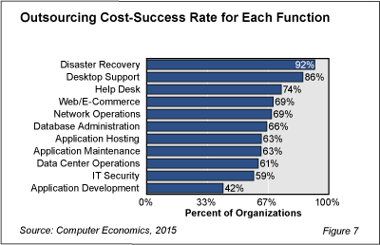
Outsourcing Problems
Outsourcing to experts could be expensive.
Security risk – outsourcing critical systems.
Loss of control - Owner doesn’t own the system entirely, risk depending on the vendor.

Slide 38
Summary
The system planning phase allows a company to examine its purpose, vision, and values and develops a mission statement, which leads to goals, objectives, day-to-day operations, and business results that affect company stakeholders. Besides, an analyst reviews the business case, which is the basis for a proposed system.
The feasibility studies conducted by a potential developer aimed to assess if the project can be done according to the owner’s requirements.
Project resource planning is important, to estimate the time and cost of the project, equipment planning, and risk planning.
IT outsourcing is the use of external service providers to deliver IT-enabled business processes, application services, and infrastructure solutions for business outcomes. Due to a lack of expertise to handle the task, companies want to concentrate on the main business, to transfer risk, or cost-saving.

Slide 39
Question & Answer

Slide 40
Next Session
System Planning Part 2

